Slide 1

GHOSTED
®
When All the Other Jobs Don’t Get Back to You…

Slide 2

Amir Aliyu
Education:
Bachelors in Computer Science, UDUS
Professional Career:
Insurance Agent
Avid aviator

Slide 3
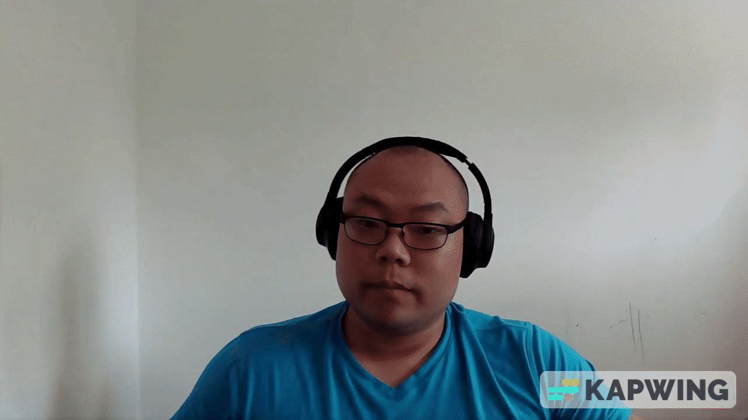
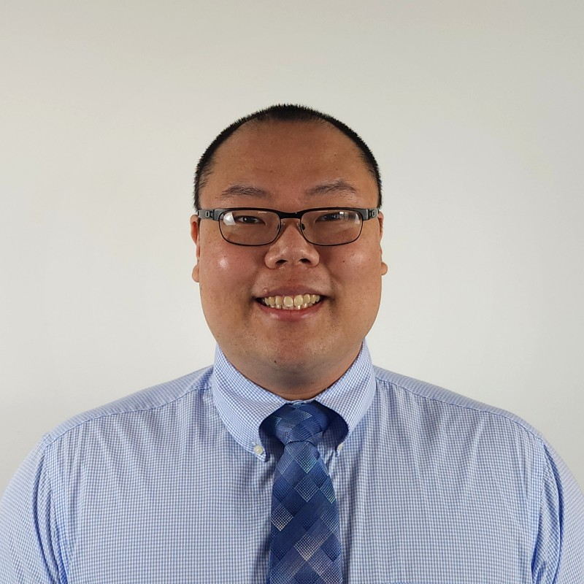
Joseph Lee
Education:
Bachelor’s in Business Administration, UMGC
Experience:
Business Analyst @ Fintech, seeking more tech-focused role
Previous passion for healthcare (nursing student) Looking to sink my hands in code, not people

Slide 4
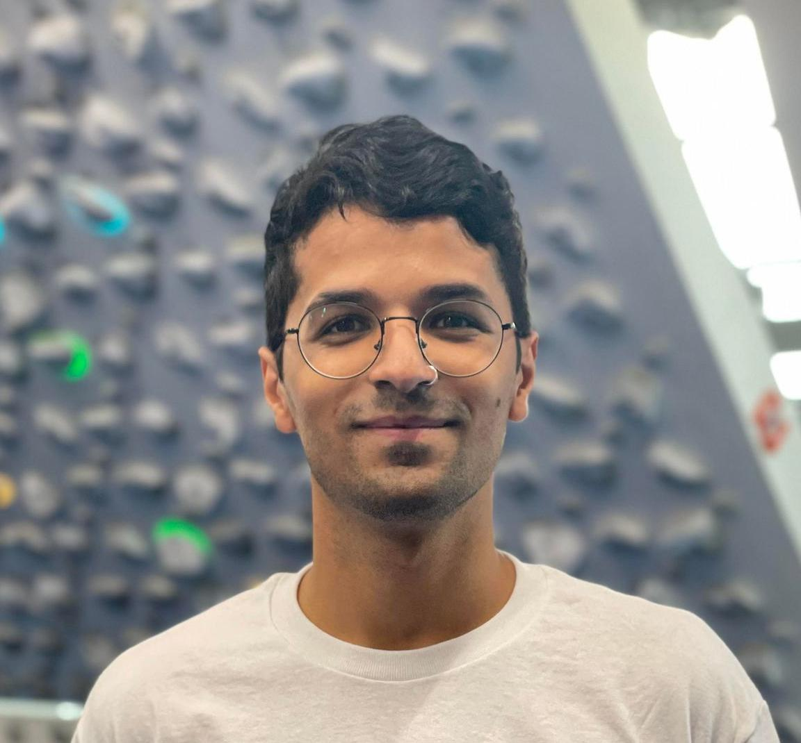
Andrew Robles
Education:
Bachelors in Music, City University of New York
Experience:
Program Lead in Education industry
Touring musician
Excited to positively affect many lives through technology

Slide 5
Introduction: Ghosted
What is Ghosted?
Streamline the job application process.
What are the main features?
Dashboard
Data driven
Resources archive.

Slide 6







Tech Stack:
Database: MySQL
Backend: Spring Boot, Java
Frontend: React, TypeScript, Tailwind
Learning Goals:
TypeScript, Tailwind, React-Chart.js API
(New) (New)

Slide 7
Achievements
Collaborate Efficiently
New technologies
Separation of concerns
Bugs
Design

Slide 8
Live Demo

Slide 9

Challenges
Git: Conflicts
Git: Branches
Git: Blame
Tailwind
TypeScript
Credit: XKCD

Slide 10
Q&A

